Slide 1
Supporting Children and Youth Dealing with the Loss of a Parent or Caregiver
Our Digital Dialogue will be starting shortly. In the interim help us learn about you by filling out the two poll questions shown.
Note: If you are unable to see and/or answer the poll question, you are most likely using the Zoom Web Client. Please download the Zoom Desktop Client to enable all features of this webinar.
Notes:
Chiara please create two opening polls:
Closed Ended:
What brings you to our digital Dialogue today?
I/my program currently supports one or more children who have experienced bereavement or loss
This is an issue that has come up for us in the past
We are expecting to deal with this issue in the future
I am just curious about this topic
Other _______________________________
Open Ended: If you are or have dealt with supporting children experiencing bereavement and their families, what do you find that families need that you find most challenging to provide?

Slide 2
Supporting Children and Youth Dealing with the Loss of a Parent or Caregiver
Notes:
2:00, :30 sec
Welcome & Airplane Check

Slide 3
Introducing Our Presenters
Deborah Langosch, PhD, LCSW
Psychotherapist/Consultant
GrandFamilies Journal and the Grandparents Outcome Work Group
Irwin Sandler, PhD
Resilient Parenting for Bereaved Children
Notes:
2:00:30; .30
Nilofer introduces panelists and asks audience grounding question
Audience Questions:

Slide 4
How does the loss of a primary caregiver impact children?
6.6% of U.S. children experience the death of a parent (Burns et al., 2020)
Parental death increases risk for prolonged grief, substance use and mental health problems and impaired academic and social functioning in childhood and (Melham et al., 2008)
Parental death increases risk for depression, internalizing problems and suicidal behavior in adulthood (Keyes et al., 2014)
Family Matters: Providing Support to Kinship care providers
Notes:
2:01; 4 minutes
Nilofer: Let’s start with some context. Help us understand how losing a primary caregiver can negatively impact children.
Irwin: (2 min). Research on long-term impacts
Deborah: (2 min).

Slide 5
How does the loss of a primary caregiver impact children?
Children express grief differently than adults. Beliefs, behavior and feelings
Language of loss and waves of grief
Developmental and cultural differences and responses
Notes:
2:05; 3 minutes
Nilofer: Deborah, as a clinician I’d love for you to talk more about what grief, loss, and disruption look like when experienced by children.
Deborah: (2 min).
Irwin: (1 min).

Slide 6
What happens when caregivers and children are both grieving
Notes:
2:08; 4 minutes
Nilofer: You both work with a lot of kinship families I want you to talk briefly about what it looks like when both children and their caregivers are grieving.
Irwin: (2 min).
Deborah (2 min)

Slide 7
Why we need to worry about this right now
Nationally more than 250,000 children have lost a parent or primary caregiver due to the pandemic¹ and globally, it’s been 5,200,000 children².
Recently child loss and grief programs report seeing more youth who have directly witnessed deaths from illness, substance abuse, community and family violence which can cause more traumatic responses. Covid adjacent fears and worries
Notes:
2:12; 2 minutes
Nilofer: Grief and loss have always been important issues for those working in child welfare to address. Why are we especially concerned with making sure that we have adequate supports in place right now?
Deborah (2 min)

Slide 8
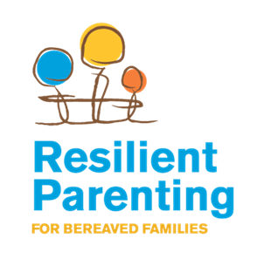
Promoting Resiliency and Protective Factors
30 years of research on the Family Bereavement Program led us to two conclusions
Many of the family and child level sources of resilience can be strengthened
Strengthening sources of resilience reduces the long-term problem outcomes of bereaved children
Notes:
2:14; 10 minutes total for all slides on FBP
Nilofer: One of the reasons I’m excited to talk with you both is that you both have deep experience as clinicians and program designers in helping bereaved children and their caregivers heal. Dr. Sandler, your program, has been operating for over 30 years and has been able to demonstrate positive impacts. I want you to tell us about it.
Before you start I want to invite those who are in our audience to use the chat box to share their own strategies and learning from their work on the ground.

Slide 9
Family Bereavement Program (FBP): Parent and Child Components
Parent Component Promotes Parent Resources
Warmth
Active listening
Positive reinforcement
Effective discipline
Positive mental health
of parent
Reducing negative life events that children experience
Child/Adolescent Program Promotes Their Resources
Coping efficacy
Adaptive coping
Adaptive control beliefs
Adaptive emotional expression
Reducing threat appraisals of negative life events
Notes:
2:14; 10 minutes total for all slides on FBP
SW Dual component program – parent,child,adolescent. Used literature to identify resources that could include in program
Activities
Talking Points
An important part of healing involves taking action to accomplish these personal goals.
Next group we’ll discuss how it went.

Slide 10
Theory of the FBP
Parent Component
Parenting tools
Self-care tools
Support – other group members & leaders
Parent
Positive
Parenting and Better Psychological Adjustment and Adaptation
Child/Adolescent Component
Adaptive coping & coping efficacy
Adaptive emotional expression
Positive family relationships
Adaptive control beliefs
Support – other group members & leaders
Children
Positive Psychological Adjustment and Adaption
Family Matters: Providing Support to Kinship care providers
Notes:
2:14; 10 minutes total for all slides on FBP
SW Conceptual framework underlying program

Slide 11
Description of FBP
Designed to promote parent and child resilience resources
Separate groups for parents, children (8-12), & adolescents (12-16)
12 2-hour group sessions held once/week
Several had conjoint segment
2 individual family sessions (1 hour)
Small-group format
6-8 members
2 Master’s-level co-leaders
Program was manualized and highly structured
Emphasis on learning tools and using them outside of session
“Home practice is the program.”
Notes:
2:14; 10 minutes total for all slides on FBP
SW

Slide 12
Evaluation of the FBP
Randomized Trial with 244 parentally bereaved children in 156 families
Randomly assigned to receive FBP or the best literature we could find
Five assessments over 15 years
Pre
Post
11 months
6 Years
15 Years
Notes:
2:14; 10 minutes total for all slides on FBP
SW Before talk about evaluation – want you to think about two questions you would want to answer when evaluating a program like the FBp

Slide 13
Program Had Positive Effects on Offspring’s Adjustment 6 and 15 years Later
Intrusive grief thoughts
Suicidal thoughts or attempts
Externalizing problems
Externalizing disorder
Internalizing problems
Biological stress response
Six Years Later
Visits to MD or psychologist for mental health problems
Use of psychiatric medication
Mental health problems reported by people who knew them well
Fifteen Years Later
Notes:
2:14; 10 minutes total for all slides on FBP
SW Here are effects at 6 yr. and 15 yr. follow-ups – offspring were between 14 and 22 – 6 yr. and 23 to 31 – 15 yr.

Slide 14
Program had Positive Effects on Parents’ Adjustment 6 and 15 Years Later
Complicated grief (11.8% vs. 0%)
Depression
Alcohol abuse
Six Years Later
Alcohol abuse
Attendance at support groups
Fifteen Years Later
Notes:
2:14; 10 minutes total for all slides on FBP
SW Effects for parents at 6 and 15 yr follow=ups
Incredibly gratifying – program led to long term improvements in multiple outcomes have important implications for reducing the public health burden of parental death

Slide 15
How did the program work?
Four factors seem to account for effects of the program
Strengthening positive parenting
Reduce exposure to stressful events
Increase child perceived coping efficacy
Increase child emotion regulation (don’t need to hide their feelings
Strengthening these factors immediately following the program account for long term benefits six and fifteen years later.
Notes:
2:14; 10 minutes total for all slides on FBP
IS

Slide 16
Program Responses: What We Learned During the Pandemic
Responded to not just to death but to the array of needs families were coping with such as academic success, peace of mind, income, health.
Greater emphasis on permanency planning—standby guardianship, advance directives.
Expanded group offerings: “Littles, Middles and Teens.”
Trained staff to understand more about grief and loss and be better equipped to respond to the needs of grieving families as well as conduct risk assessments.
Used technology—Zoom—to reach more clients in diverse places, School based programs closed so Zoom became alternative.
* JBFCS Child and Adolescent Loss and Bereavement Program
Notes:
2:24; 5 minutes
Nilofer: Deborah, you are in New York, which was so deeply impacted during the pandemic you’ve seen programs have to adapt to meet the sudden upsurge in need. Tell us more about how they’ve responded and what we can learn from them.
Deborah:
Survey of five grief and kincare programs. Impressive and creative shifts and pivots. Tremendous increase of support in many meaningful ways

Slide 17
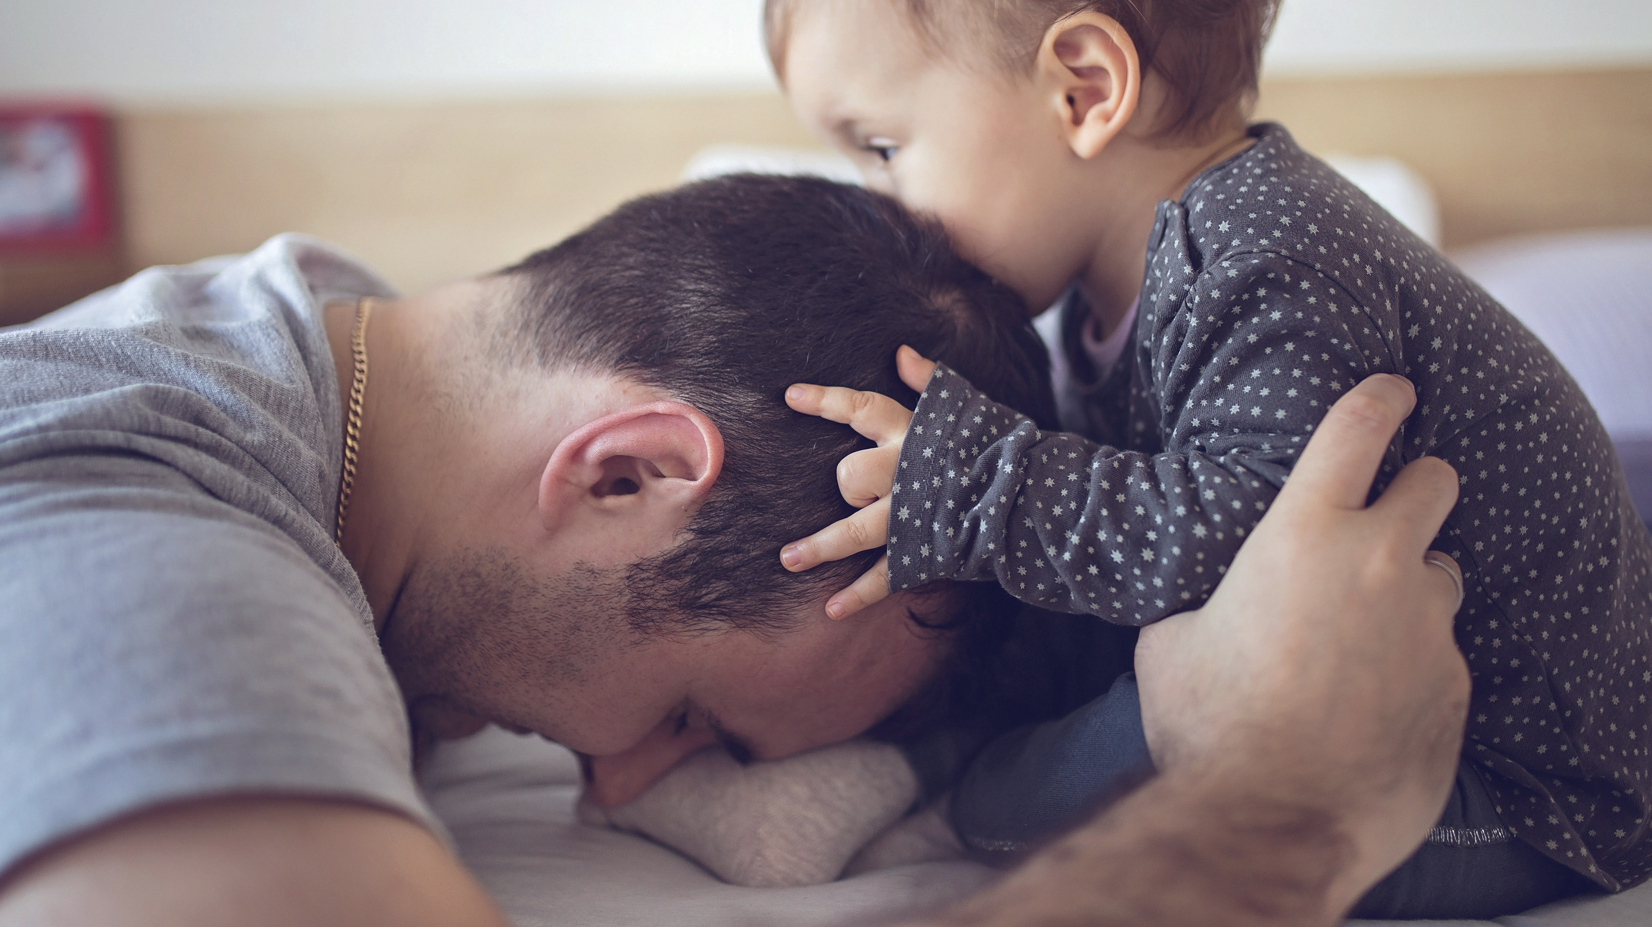
Program Responses: What We Learned During the Pandemic(Cont).
Developed more parent/caregiver supports – groups, workshops, self-care focus.
In support groups- focused on COVID precautions, access to reliable info on vaccinations as well as promoting better health and well-being, and accessing services for concrete needs.
Connected clients to grief and loss counseling, supports and services, including grief groups.
Developed an active and current list of community resources including grief camps, counseling and respite services.
Dire need for respite.
Offered weekly consultation group time for providers to process grief, changes, and challenges.
Partnered with more programs, i.e., Children’s Aid, Legal services.
Addressed secondary trauma and importance of self-care for staff.
Notes:
2:29; 4 minutes

Slide 18
Resources
Traumatic Grief, National Child Traumatic Stress Network
https://www.nctsn.org/what-is-child-trauma/trauma-types/traumatic-grief
ACF Letter: Addressing the Impacts of Parent and Caregiver Loss on Children
https://www.acf.hhs.gov/policy-guidance/addressing-impacts-parent-and-caregiver-loss-children
Grand Families and Kinship Support Network
https://www.gksnetwork.org/
Promoting Healthy Behaviors for Kinship Caregivers
Notes:
2:33; 4 minutes

Slide 19
Notes:
2:40; 20 minutes

Slide 20
Deborah Langosch, PhD, LCSW
Email address: drlangosch@gmail.com
https://scholarworks.wmich.edu/grandfamilies/
https://www.grandfamilieswork.org/
Irwin Sandler, PhD
Email address: Irwin.sandler@asu.edu
https://www.bereavedparenting.org/

